Slide 1
Migrating your messaging workloads to the Cloud
With Azure Service Bus

Slide 2

Speaker Bio
Eldert Grootenboer
He/Him
Program Manager Service Bus
@egrootenboer
egrootenboer@microsoft.com

Slide 3
Azure Messaging

Slide 4


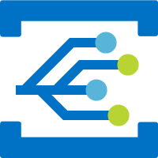

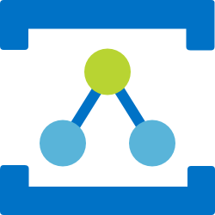
Messaging in Azure
Storage Queues
Simple task queues
Service Bus
Enterprise messaging
Event Grid
Cross cloud reactive eventing
Event Hubs
Streaming data
Relay
Secure sockets without changes to your network

Slide 5
Messaging is essential to modernization
Asynchronous
Loose coupling
Responsiveness
Horizontal scalability

Slide 6
Azure Service Bus

Slide 7
What is Azure Service Bus?
Platform-as-a-Service Queue and PubSub message broker
Fully managed
JMS 2.0 and AMQP 1.0 compliant
Polyglot Azure SDK
Cross-platform client support
Industry-leading reliability and availability
Integration with other Azure services
Notes:
Platform-as-a-Service Queue and PubSub message broker
Fully managed: You use the features, Azure deals with everything else
JMS 2.0 and AMQP 1.0 standards compliant
Polyglot Azure SDK and cross-platform client support
Industry-leading reliability and availability
Integration with other Azure services
Idiomatic language support
.NET
Java
JMS 1.0 and 2.0
Azure SDK for Java
Python
Typescript
Go
Integration with other Azure services
Event Grid
Logic Apps
Azure Functions
Power Platform
Dynamics 365
Stream Analytics

Slide 8
Enterprise Messaging as a Service
Queues & Topics
Reliable asynchronous communication
Message headers
Routing and filtering
Rich features

Slide 9
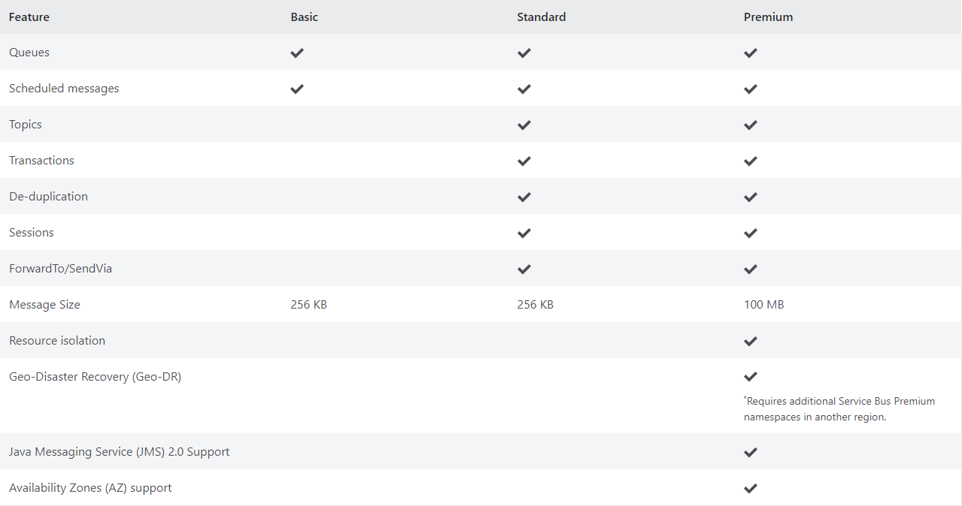
Messaging your way
Notes:
Scheduled delivery
Time To Live
ForwardTo
Defer
Sessions
Batching
Auto-delete queue on idle
OnMessage
Duplicate detection
Actions
Transactions
Poison message handling

Slide 10
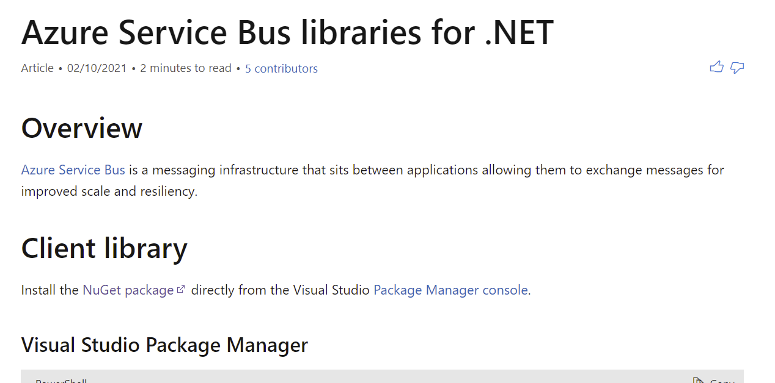
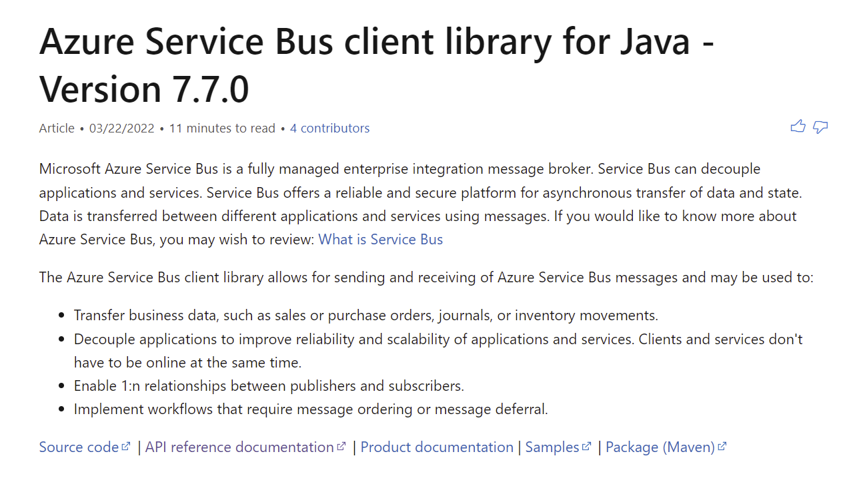
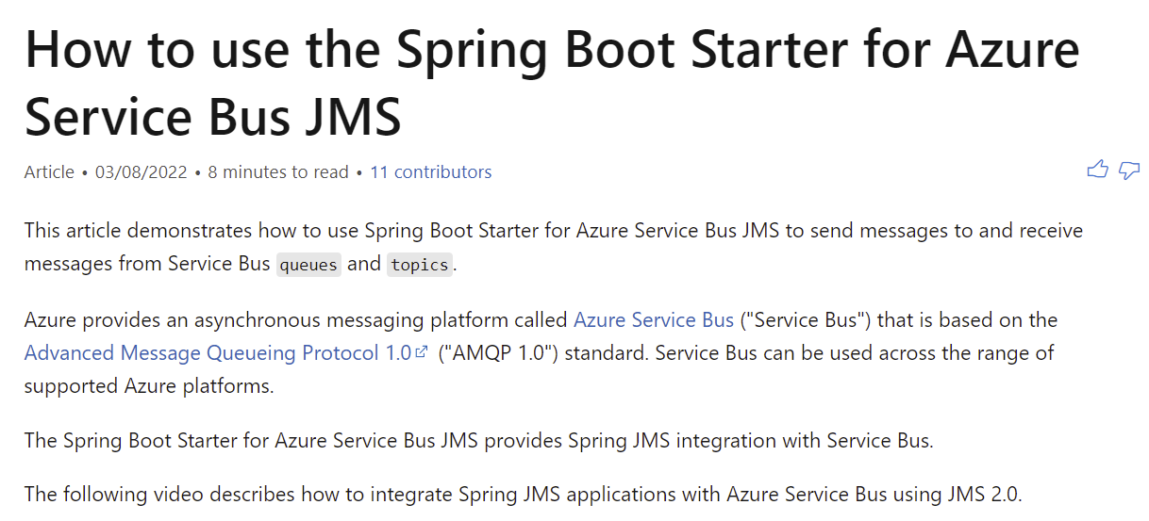
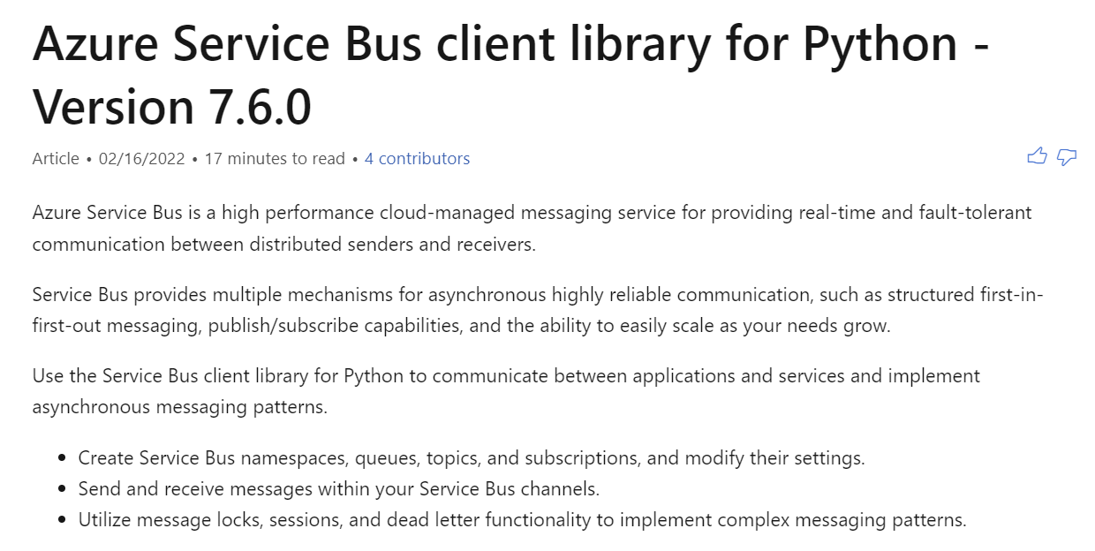
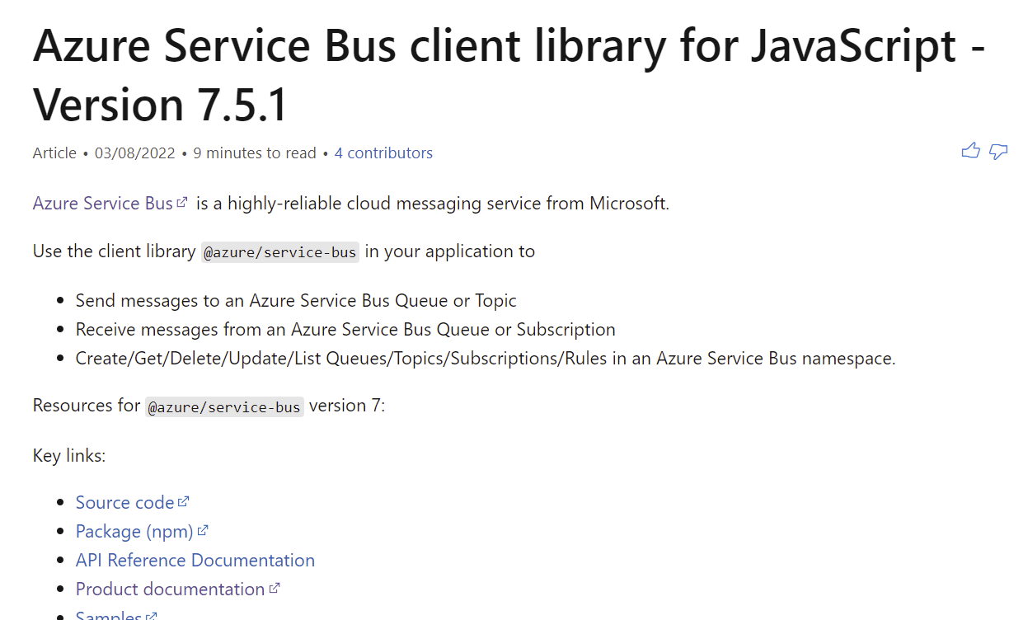
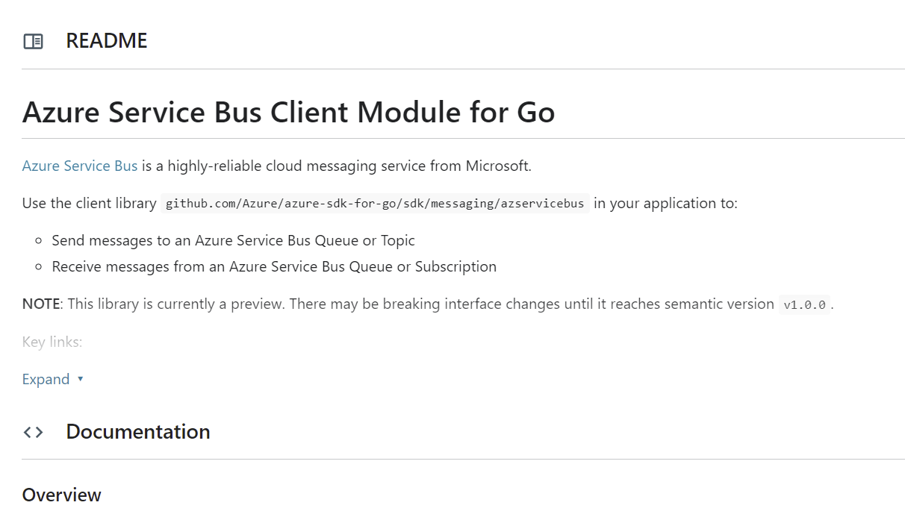
SDK Support: Azure SDKs
.NET
Java
Java Spring Boot
Python
JavaScript/Typescript
Go

Slide 11
JMS on Service Bus

Slide 12
Java Messaging System (JMS) is a very mature market space
Lowest common denominator in Java
Very mature within that market
Many commercial and open-source implementations
Notes:
Java Messaging System (JMS) lowest common denominator in Java
JMS is very mature within that market
1.0 in 1998
2.0 in 2013
3.0 in 2022
Many commercial and open-source implementations of JMS
TIBCO EMS
WebSphere MQ
Active MQ
Azure Service Bus
Others

Slide 13
You're running a JMS 2.0 broker cluster in your own datacenter? Azure Service Bus is quite possibly
More reliable
Less costly to own
Less costly to operate
Milliseconds away from existing workloads
Easy to integrate into network
Notes:
IBM? TIBCO? Red Hat? Apache? VMWare?
Azure Service Bus is quite possibly
more reliable with better 24/365 uptime (no service windows)
far less costly to own (no initial/recurring licensing fees)
and far less costly to operate (fully managed, no hardware)
just a few milliseconds away from your existing workloads
fairly easy to integrate into your network via VPN Gateway

Slide 14
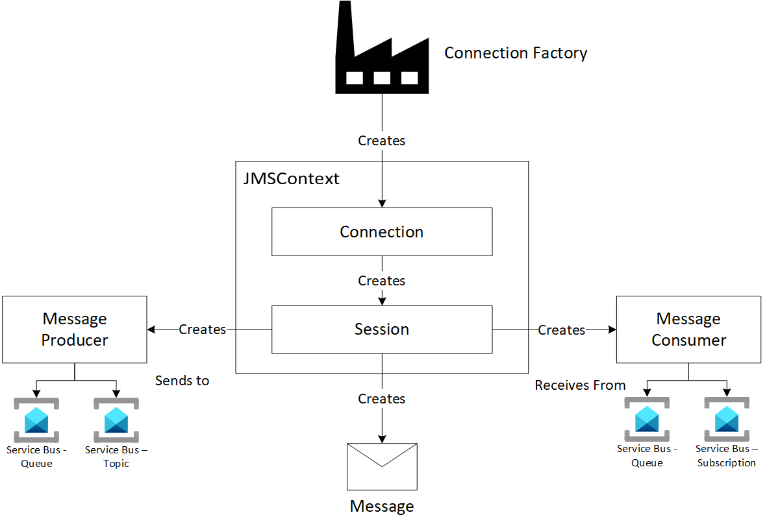
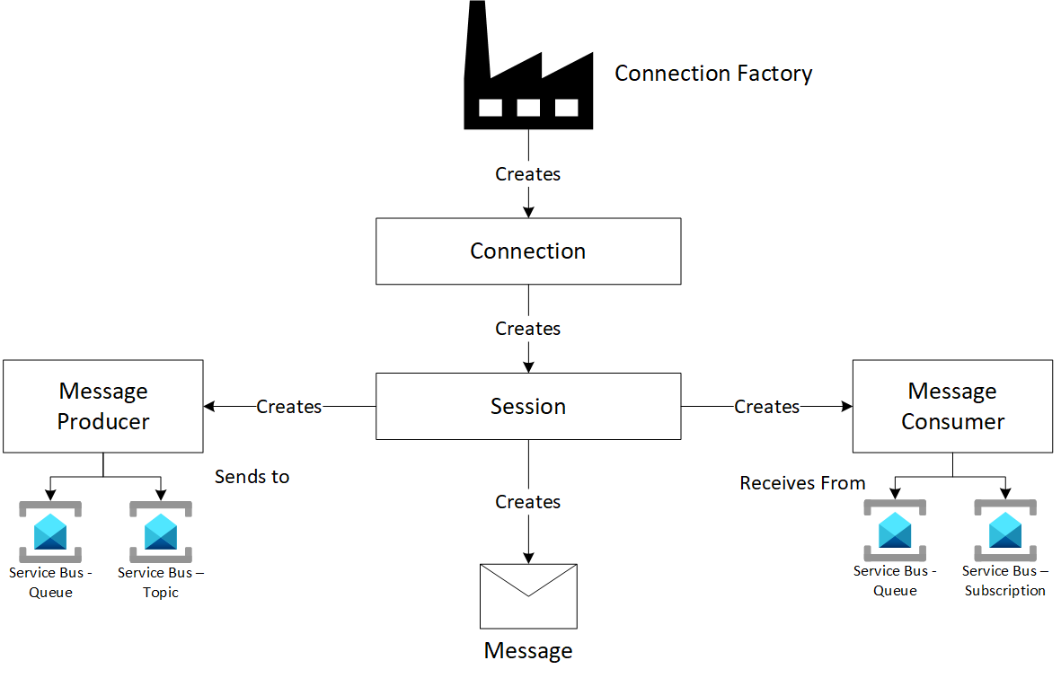
Using JMS with Azure Service Bus
JMS 1.1
JMS 2.0
Notes:
Use the Java Message Service (JMS) with Azure Service Bus and AMQP 1.0 https://docs.microsoft.com/azure/service-bus-messaging/service-bus-java-how-to-use-jms-api-amqp
In fact, we can use JMS 1.1 APIs to connect Azure Service Bus standard tier, but support for JMS 1.1 APIs is limited as you see the warning message in the document.
Warning The below guide caters to limited support for Java Message Service (JMS) 1.1 API and exists for Azure Service Bus standard tier only. Full support for the Java Message Service (JMS) 2.0 API is available only on the Azure Service Bus Premium tier in preview, which is highly recommended.

Slide 15
Java Message Service + Large Messages
Java and Spring using JMS 2.0 APIs
Seamless migration
Works with enterprise connectors
Up to 100MB
Notes:
Connect Java and Spring applications with Azure Service Bus over the familiar JMS 2.0 APIs (first introduced in August 1998).
Seamless migrate away from IBM/Active MQ (or any other JMS provider). Enterprise integration connectors can point to Service Bus too!
Support for Large Messages – Send messages up to 100 MB on Azure Service Bus Premium.

Slide 16
SDK Support: JMS 2.0 Provider
Queues
Topics
JMS Message Selectors
Shared Durable Subscriptions
Unshared Durable Subscriptions
Shared Volatile Subscriptions
Unshared Volatile Subscriptions
Queue Browser
Temporary Queues
Temporary Topics
Delivery Delay
Cross entity transactions
Topic topic = session.createTopic(dest.toString());
MessageProducer sender = session.createProducer(dest);
TopicSubscriber topicSubscriber1 = session.createDurableSubscriber(topic, sub1Name);
TopicSubscriber topicSubscriber2 = session.createDurableSubscriber(topic, sub2Name, "JMSCorrelationID='5'", false);
MessageConsumer topicSubscriber3 = session.createSharedDurableConsumer(topic, sub3Name, "JMSCorrelationID='5'");
TextMessage message = session.createTextMessage("Text!");
message.setJMSCorrelationID(Integer.toString(i));
sender.send(message, DELIVERY_MODE, Message.DEFAULT_PRIORITY, Message.DEFAULT_TIME_TO_LIVE);

Slide 17
Migrating existing applications to Service Bus
Notes:
Migrate Java Message Service (JMS) applications from Apache ActiveMQ to Azure Service Bus - Azure Service Bus | Microsoft Docs

Slide 18
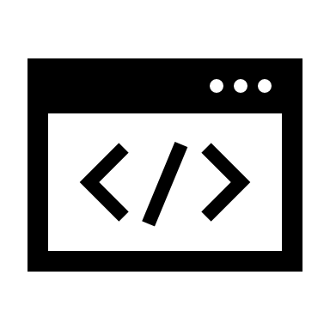








How can I migrate my applications?
Configuration
OR
application.properties
OR
Take an
existing application.
Import “azure-servicebus-jms”
Maven package
OR
Spring starter for Azure Service Bus.
Add Azure Service Bus
connection string.

Slide 19
Demo Time!

Slide 20
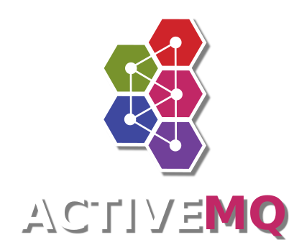



Demo – JMS 1.1 and Service Bus Standard
Notes:
Queue

Slide 21
Demo – JMS 2.0 and Service Bus Premium
Notes:
Topic with filtered subscriptions
Temporary queue
Scheduled message
Large message

Slide 22

Demo – JMS 2.0 and Service Bus Premium
Notes:
Topic with filtered subscriptions
Temporary queue
Scheduled message
Large message

Slide 23
Almost done

Slide 24
Why fix something that isn’t broken?
Other MQs
Azure Service Bus
Deployments & Disaster recovery
Create, manage and scale compute and storage infrastructure.
License the MQ (if applicable).
Build paired regional configuration.
Usage & Management
Build and manage custom applications to integrate with Azure PaaS.
Integrate with 3rd party tools to monitor your MQ deployment.
Deployments & Disaster Recovery
Easy setup - Simply provision a Service Bus namespace with Messaging units (MU). And seamlessly scale up/down the MUs to accommodate spike in the load.
Simple pricing – Pay per MU provisioned (hourly billing).
First class HA & DR – Seamlessly build fault isolation both intra and inter region.
Usage & Management
Integrate and simplify workflows with Azure Logic Apps and Functions.
Monitor – Utilize Azure Monitor to alert the right stakeholders and mitigate seamlessly.
Encrypt data at rest with Customer managed key (BYOK).
Secure access with Virtual networks and Private endpoints.
Manage and limit operations with Azure Active Directory(AAD) backed RBAC.
Notes:
when Asir was operating at the container-level, we saw how he provisioned resources and deployed every Spring Cloud component by himself. It is more than deployments; he needs to manage them for life. In contrast, when customers are using PaaS, you just create an Azure Spring Cloud

Slide 25




Thank You
@egrootenboer
servicebuspm@microsoft.com
https://www.linkedin.com/in/eldert-grootenboer
https://aka.ms/AzureEventHubs-Feedback

